Slide 1
Low-Code/No-Code Development
Ravishka Rathnasuriya PhD Student

Slide 2
What is Low-Code/No-Code (LCD/NCD) Development?
Low-Code: Creating software with small amount of code by reducing the amount of traditional hand coding.
No-Code: Create software using graphical user interfaces and configuration instead of traditional computer programming. Closely related to Low-Code development platforms.
Other definitions: Visual Programming, Drag-and-drop. Graphical User Interface, What you see is what you get.

Slide 3
Why Low-Code/No-Code Development is Getting Popular?
Research company Gartner says that by 2021, the demand for information systems will increase five times faster than the ability to provide them by IT departments.
Number of employees are not growing at a sufficient pace.
Recruiting software engineers has become increasingly difficult as demand is high and supply is low.
More than 50 percent of medium to large enterprises will have adopted to these application platforms by 2023
People with no programming knowledge can easily adopt to these platforms to build applications.
First Low-code integrated development environment (IDE): Visual Basic .NET

Slide 4
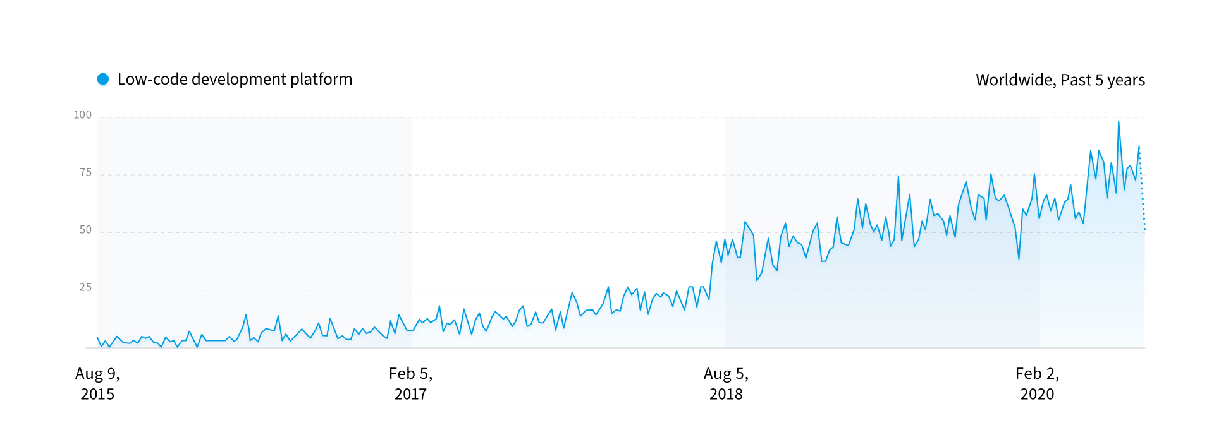
Trends

Slide 5
Traditional Development vs NCD/LCD [5]
CHARACTERISTIC | TRADITIONAL DEVELOPMENT | NO-CODE/LOW-CODE DEVELOPMENT
Development resources | Developers with expertise in programming languages for: web app development mobile app development | An intuitive drag-and-drop interface for web/mobile app development by: citizen developers professional developers
Development time | Lasts for months and includes: extensive coding multiple prototype revisions testing and bug fixes | Is accelerated by 10x thanks to: no need for coding ready-made design templates drag-and-drop interface
Development cost | Depends on the developer’s hourly rate: | Depend on the subscription plan and the number of users:

Slide 6
CHARACTERISTIC | TRADITIONAL DEVELOPMENT | NO-CODE/LOW-CODE DEVELOPMENT
Multiplatform | The app should be developed separately for each platform | The app can work: for mobile for web in the cloud
Maintenance | requires additional development is extensive to support | easy to update and extend great for prototyping
Deployment | requires many steps requires much development resources slow and complex | one-touch deployment to multiple environments

Slide 7
When to Use LCD/NCD and Traditional Development[6]
Use LCD/NCD: 1. For Business Use Cases that Drive Agile Transformation 2. Quick Application Development by Business Users 3. For Unique and Customizable Solutions
Use Software Development: 1. For Open-Ended Solutions problems require open-ended thinking
2. For Applications Requiring High Level of Specialized Interactivity applications require a high level of specialized interactivity. provide the flexibility and freedom because of infinite number of functionalities.

Slide 8
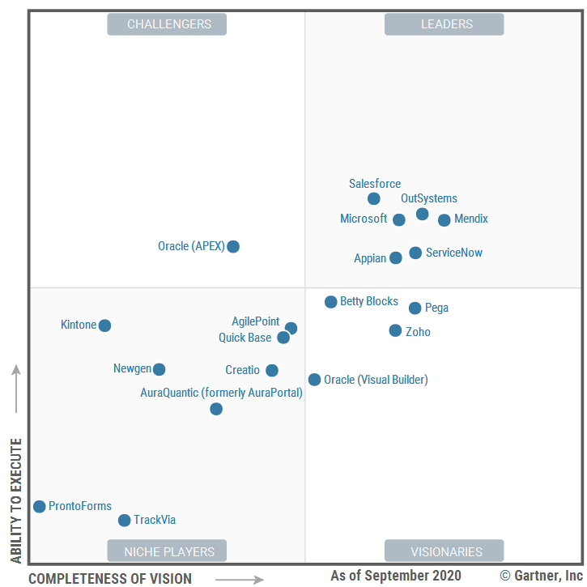
What platforms are used?
Bubble.io
Airtable
Wix ( Editor X)
WordPress
Outsystems
Microsoft Power Apps
Google App Maker
Salesforce App Cloud
Shopify
Zapier
Glide

Slide 9
Supporting Technologies Behind LCD/NCD contd.
1. React Native Development platform: Develop Android and iOS apps.
OREOPS is a low code platform to develop react-native mobile applications.
Mobile Components: Configure models for text, images, videos, lists, buttons, etc. API Integration: Integrate your app with legacy systems or third-party applications for easy data access. App Pages: Create app pages in a click and simply drag and drop components Files and Media: Ensures a simple upload of docs including Js files for effective use. SmartCode: Let you design your app with limited or no coding knowledge.

Slide 10
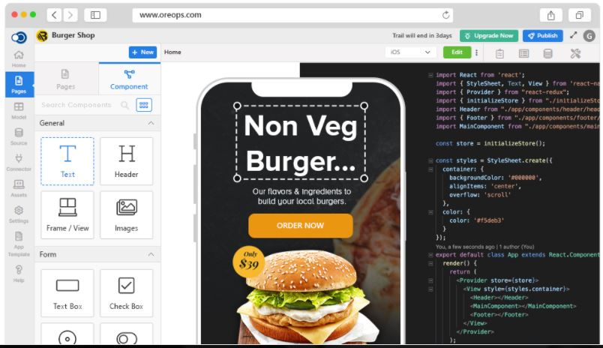

Slide 11
Supporting Technologies Behind LCD/NCD contd.
2. Node.js
Node-RED is a low-code programming for event-driven applications built on Node.js
Amplication is an open source development tool that helps to develop quality Node.js applications.
Amplication works: 1. Design model and roles : Define data entities and role-based access through Amplication’s UI or CLI, and it will auto-generate you database, an Admin UI, and API 2. Deploy your application in one click 3. Sync your app with GitHub 4. Access your app: Auto-generated admin UI based on the data model schema enables to access data with ease. 5. Connect your code using REST or GraphQL.

Slide 12
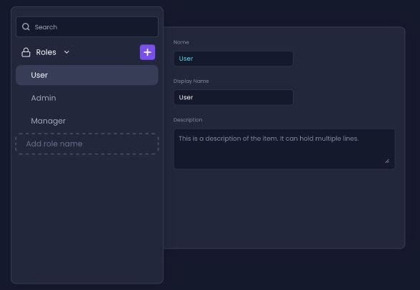
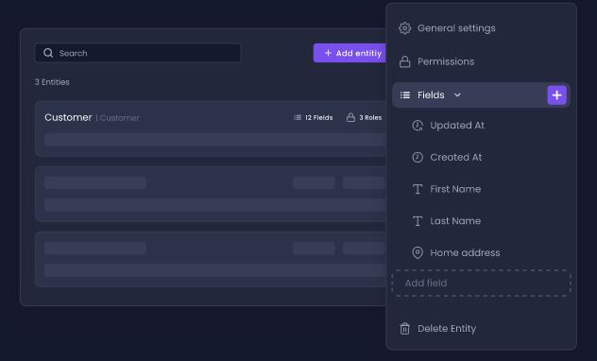
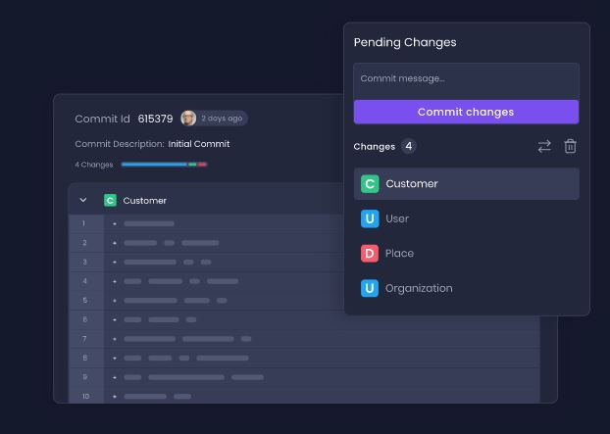
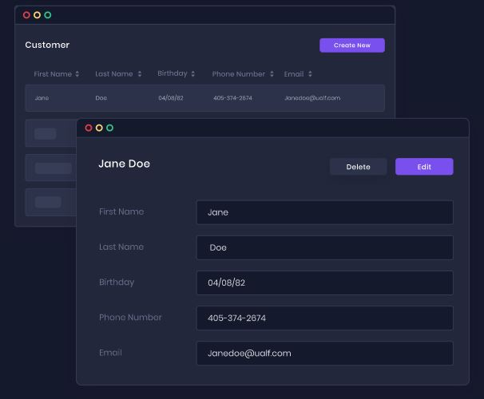

Slide 13
Supporting Technologies Behind LCD/NCD contd.
Apache Spark : Unified analytics engine for large-scale data processing
Azure Data Factory: A fully managed, serverless data integration service. Accelerate data transformation with code-free data flows. Managed Apache Spark service take care of code generation and maintenance.
Easy-to-use: Rehost SQL Server Integration Services (SSIS) in a few clicks and build ELT and ELT pipelines code-free, with built-in-Git and CI/CD support.
Cost-effective: Enjoy a pay-as-you-go, fully managed serverless cloud service that scale on demand Powerful: Ingest all your premises, and software as a service (SaaS) data with more than 90 built-in connectors.

Slide 14
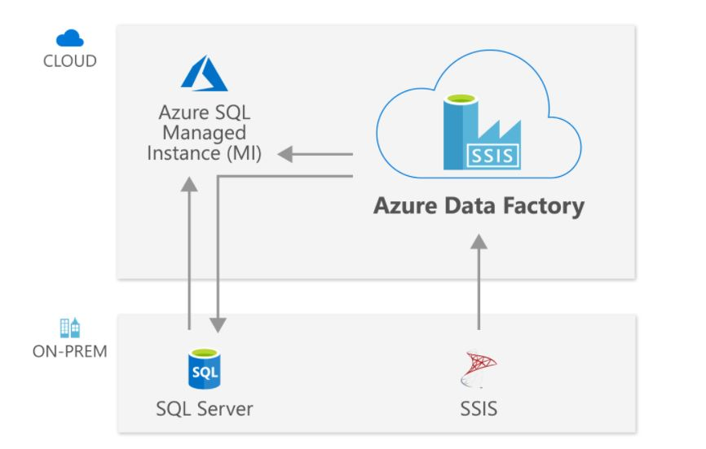
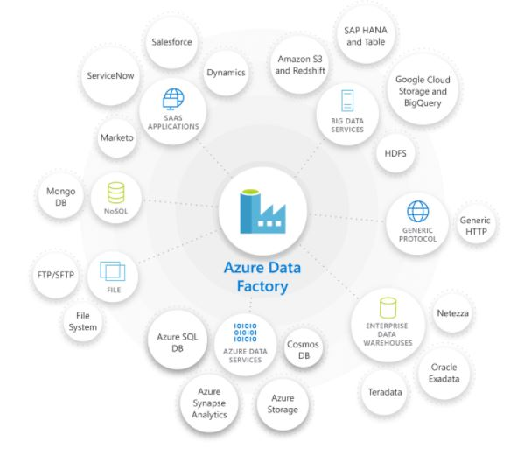

Slide 15
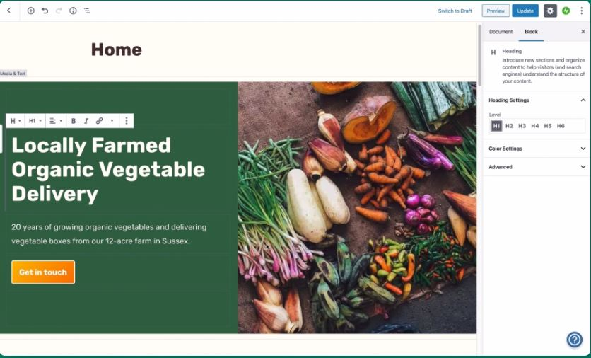
Supporting Technologies Behind LCD/NCD contd.
Server-side scripting : In web development that involves employing scripts on a web server and produces a response customized for each user’s request. Allow user to create website with zero code.
WordPress: Plugins: Infinite combinations, infinite possibility. Ecommerce: Turn your site into a store Built-in marketing: Rely on built-in SEO tools, Mailchimp, Google Analytics integrations.

Slide 16
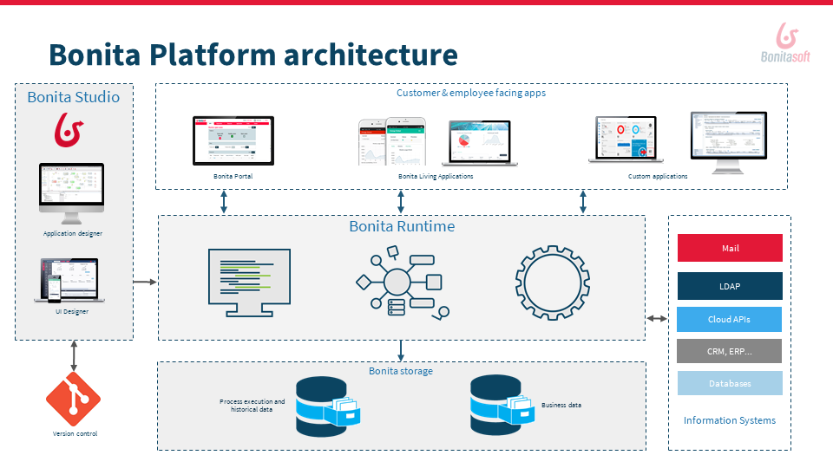
Supporting Technologies Behind LCD/NCD contd.
SOAP (Simple Object Access Protocol) : Messaging protocol specification for exchanging structured information in implementation of web services.
Bonita: Open Source digital process automation platform. Use model-driven Bonita Studio with drag-and-drop visual process design to define fundamental business logic. Use connectors and REST APIs to integrate with you enterprise technology stack.

Slide 17
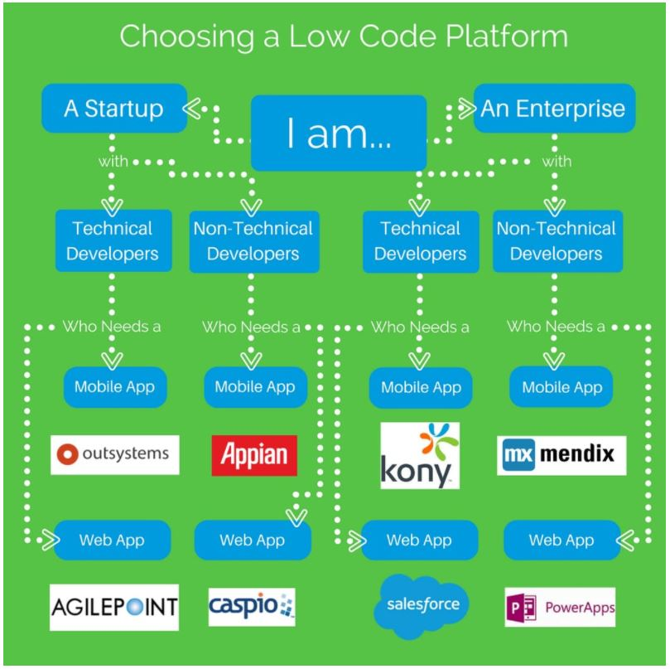
Types of Applications developed.
Mobile Applications Web Applications
[7]

Slide 18
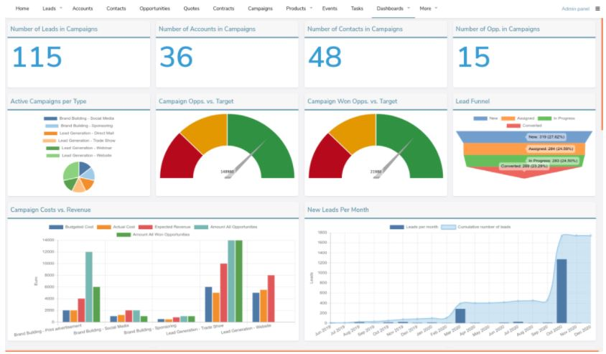
Customer Relationship Management with LCDP/NCDP [8]
A CRM is a technology for managing all the company’s relationship and interactions with customers and potential customers. Marketing sales, customer service, and support.
Works as a customer data storage software, data analytics, interactive dashboards.
Advantages: Quick application development, low development cost, no programming knowledge needed.

Slide 19
LCDP/NCDP for HealthCare [9]
Healthcare applications are developed with privacy, security, and compliance. A low code platform built specifically for healthcare means that all applications are custom built in a secure and HIPAA compliant environment.
Use Cases for using in healthcare: 1. Patient Safety: Care teams can integrate solutions make it easier for team members to report incidents and events, manage events, perform reviews. 2. Quality Monitoring and Clinical Rounding Tools: Can build tools to support clinical rounding. Supports quality monitoring tools to make it easy to share data, measure outcomes, track clinical performance. 3. Employee Health: Can build an app to make it easy to stay up-to-date on employee health activities and records. Features: Capability with mobile, tablet, and desktop devices, cloud hosting, HIPAA compliant, interoperability with other health IT systems and legacy systems.

Slide 20
Workflow and Business Process Management with LCDP/NCDP [10]
BPM: Is a discipline to improve business processes that sustain the operations.
LCDP/NCDP allows to automate business processes and workflows completely without programming skills.
1. Defining the structure to store data: Tools provide a form generator to allow to drag and drop different fields into a form, that centralize all relevant information. 2. Drawing the process flow in an appropriate notation: Define the workflow. (Standard is BPMN diagrams: super simple, complete). Allows user to draw their process. So it is easy to specify a process in minutes, and clearly documented.
3. Deploying the process and go into production in 1 click: Pressing a single button, the process is deployed and made available for end-users.

Slide 21
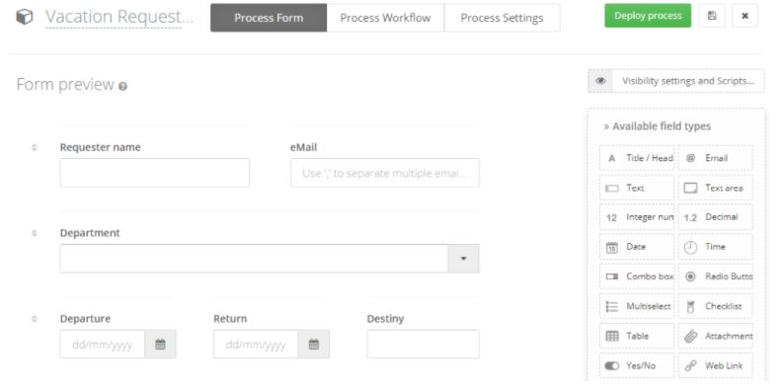
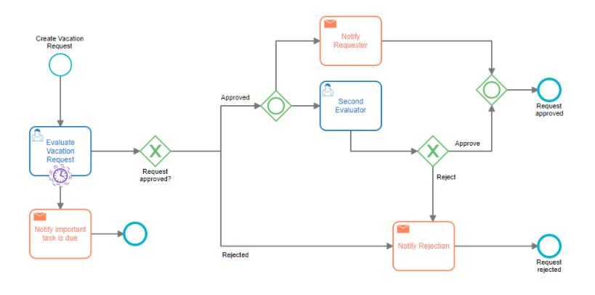
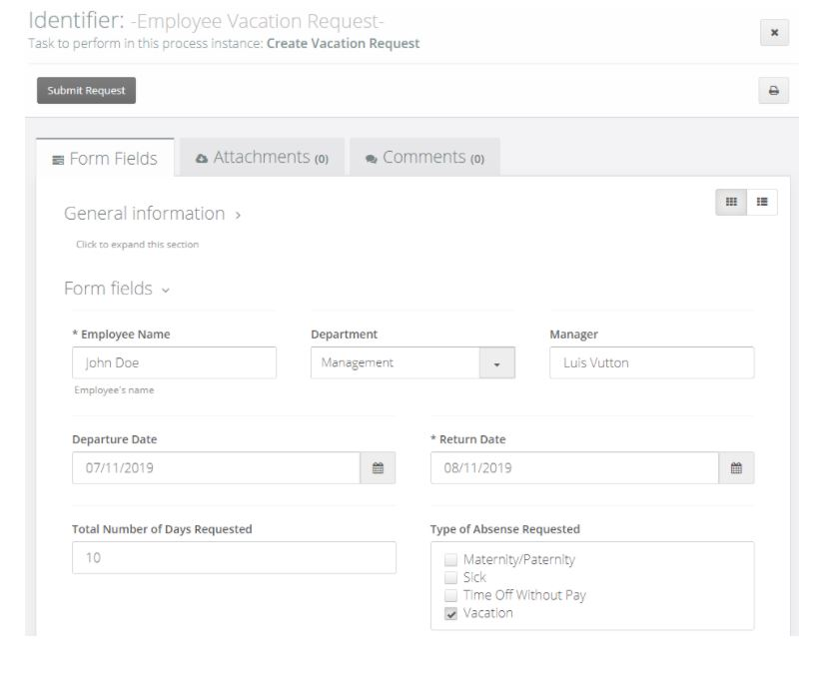

Slide 22
Other Kinds of Supported Applications:
Event Monitoring
Process Automation
Approval Process Control
Escalation Management
Inventory Management
Quality Management
Workflow Management

Slide 23
Benefits
Faster development
Ease of study and use
Lower IT cost (Open-source)
Rich and ready-to-use units
Newbie friendly
Improved system quality
Strong integration and expansion capability
Minimal efforts
Better user experience
Improved IT governance

Slide 24
Limitations and Challenges
High learning curve
High pricing
Lack of customization
Slow loading and publishing
Less powerful than programming
Complex issues still need coding
No access to source code
Limitations for experience developers
Vendor lock-in
Difficulty of maintenance and debugging
Need of basic programming knowledge

Slide 25
Capabilities that a LCD/NCD platform can Offer and their features[2]
Graphical User Interface: Represents provided functionalities available in frontend. Features: Drag-and-drop tools, forms, point and click approach, pre-built dashboards, built-in workflows
Interoperability support with external services and data sources: possibility of interacting with external services. (Dropbox, Zapier, Office 365) Features: Interoperability with external services, connection with data sources
Security Support: Security aspects like authentication mechanisms, adopted security protocols. Features: Application, Platform security
Collaborative Development Support: Collaboration models. Features: on-line, off-line collaborations
Reusability Support: Enable to reuse already developed artifacts. Features: Built-in workflows, Pre-built forms/ reports, pre-built dashboards.

Slide 26
Capabilities and Features Contd.
Scalability Support: Scale up applications according to different dimensions. Features: Scalability on number of users, data traffic, data storage.
Business Logic Specification Mechanisms: Specify the business logic of the application modeled. Features: Business rule engine, graphical workflow editor, AI enabled business logic, API support
Application Build Mechanisms: Ways the application is built. Features: Code-generation, models at run-time.
Deployment Support: Deploying the modeled application. Features: Deployment on cloud, local infrastructures.

Slide 27
References
1. https://arxiv.org/pdf/2107.07482.pdf
2.https://www.researchgate.net/publication/344842798_Supporting_the_understanding_and_comparison_of_low-code_development_platforms
3. https://www.youtube.com/watch?v=jaRCENYBuYo
4. https://www.youtube.com/watch?v=JwM9NrePPMc
5. https://steelkiwi.com/blog/traditional-coding-vs-no-codelow-code-development/
6. https://www.zoho.com/creator/decode/low-code-vs-traditional-development/
7. https://stackify.com/low-code-dev-platform/
8. https://www.crust.tech/why-is-a-crm-based-on-low-code-your-best-option/
9. https://www.performancehealthus.com/blog/low-code-solutions-drive-digital-transformation
10. https://www.flokzu.com/blog/en/uncategorized-en/low-code-no-code-workflow-bpm-platforms-give-it-a-breath/

Slide 28
Acknowledgement
Dr. Wei Yang

